Slide 1

Malignant comments
By
Ria maitra

Slide 2
introduction
The Internet has allowed people across the world to connect instantaneously and has revolutionised the way we communicate and share information with one another. More than 4 billion people were Internet users in 2018, more than half of the global population.
In many ways, the Internet has had a positive influence on society. For example, it helps us to communicate easily and to share knowledge on all kinds of important topics efficiently: from the treatment of disease to disaster relief. But the Internet has also broadened the potential for harm. Hateful messages and incitements to violence are distributed and amplified on social media in ways that were not previously possible.
This has resulted in the emergence of conflict and hate, making online environments uninviting for users. Although researchers have found that hate is a problem across multiple platforms, there is a lack of models for online hate detection.

Slide 3
Problem statement
The proliferation of social media enables people to express their opinions widely online. However, at the same time, this has resulted in the emergence of conflict and hate, making online environments uninviting for users. Although researchers have found that hate is a problem across multiple platforms, there is a lack of models for online hate detection.
Our goal is to build a prototype of online hate and abuse comment classifier which can used to classify hate and offensive comments so that it can be controlled and restricted from spreading hatred and cyberbullying.

Slide 4
objective
To find out the most used abusive words in the comment section.
To build models to classify type of comments

Slide 5
Data collection
The data set contains the training set, which has approximately 1,59,000 samples and the test set which contains nearly 1,53,000 samples. All the data samples contain 8 fields which includes ‘Id’, ‘Comments’, ‘Malignant’, ‘Highly malignant’, ‘Rude’, ‘Threat’, ‘Abuse’ and ‘Loathe’.
The label can be either 0 or 1, where 0 denotes a NO while 1 denotes a YES. There are various comments which have multiple labels. The first attribute is a unique ID associated with each comment.

Slide 6
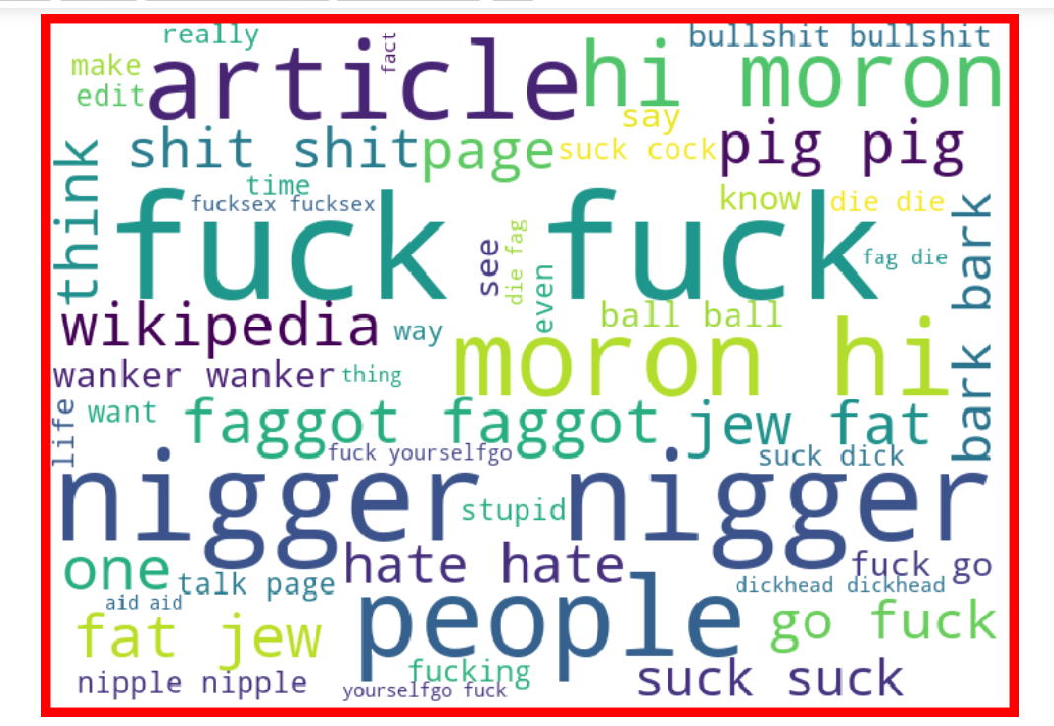
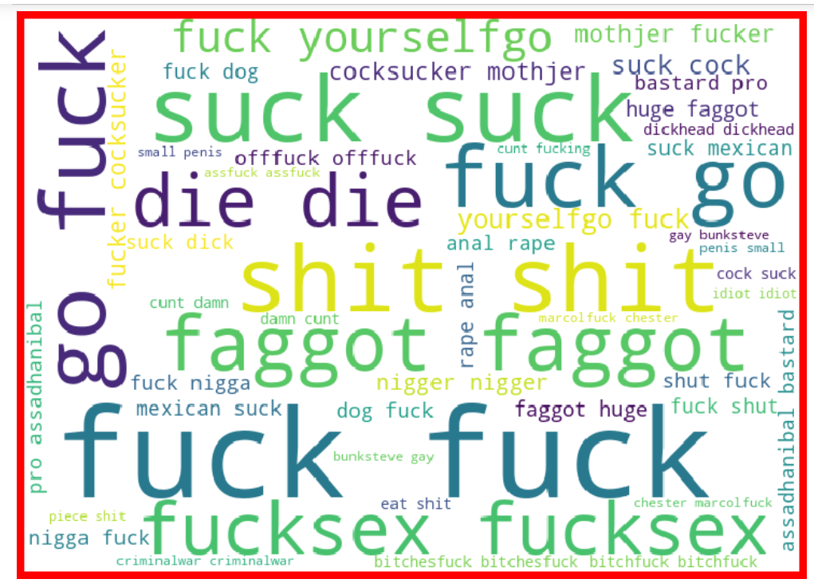
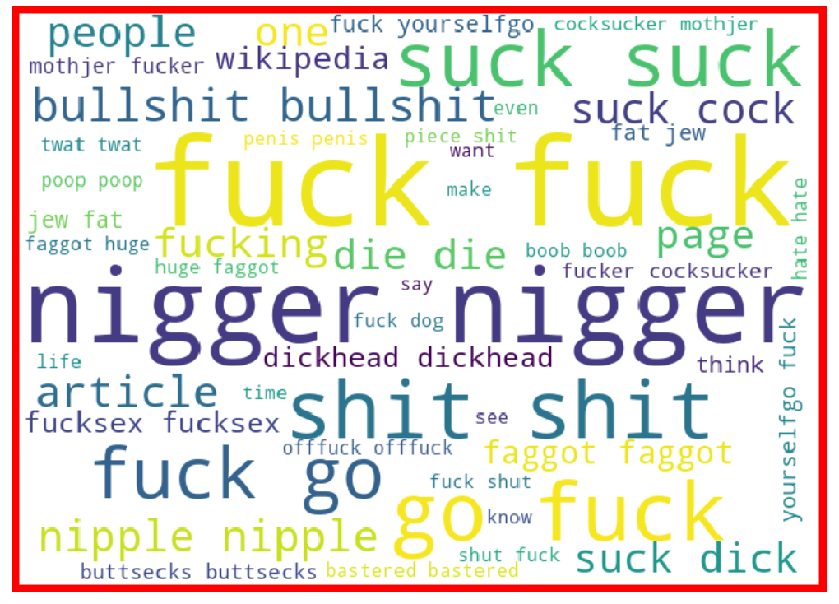
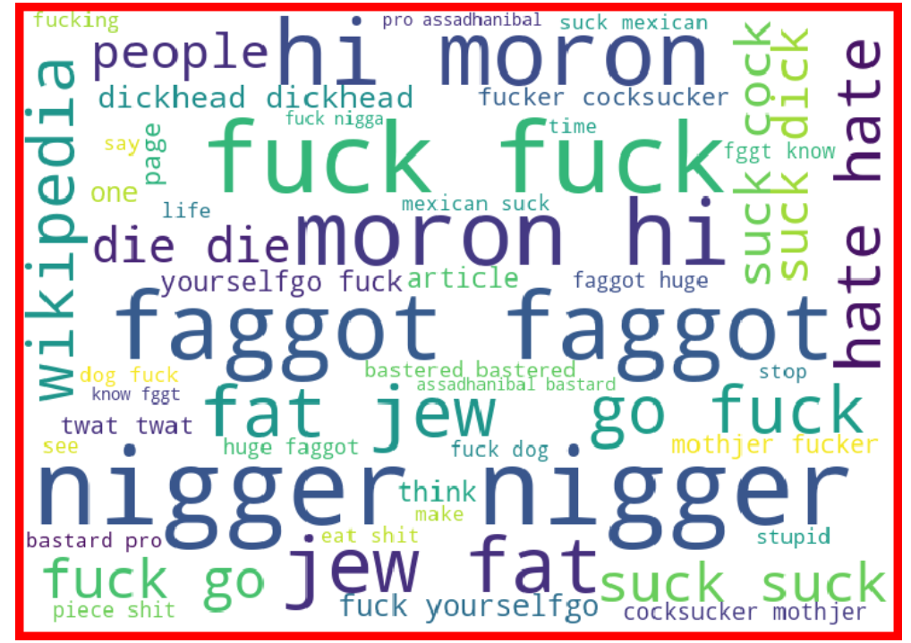
Loud words

Slide 7
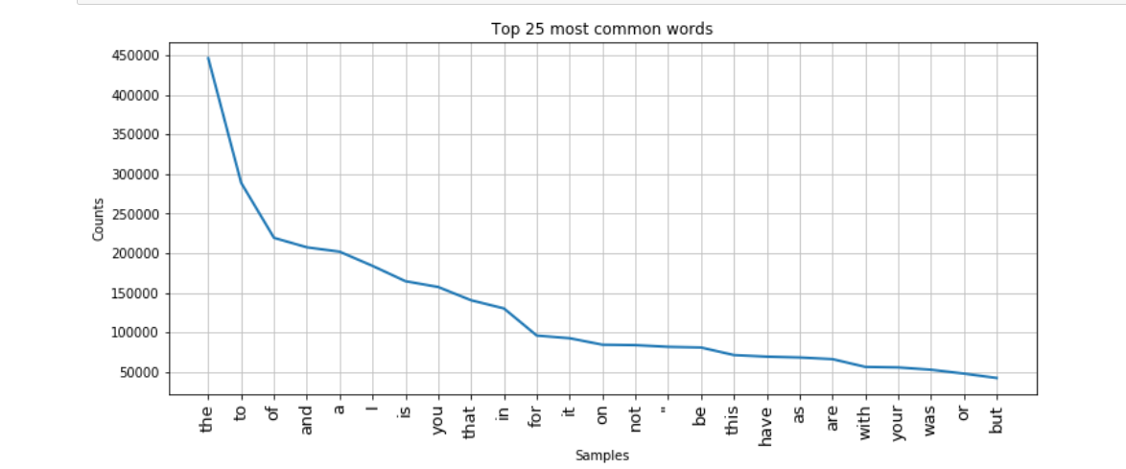
Frequency of words
Checking frequency of words before cleaning the text comment

Slide 8
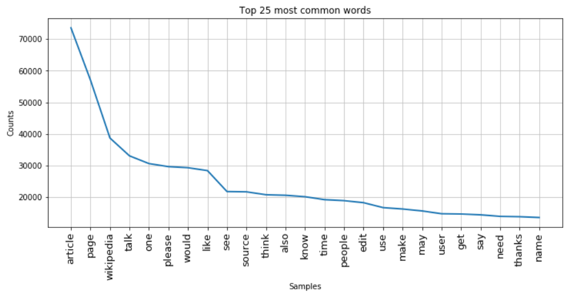
Checking frequency of words after cleaning the text comment

Slide 9
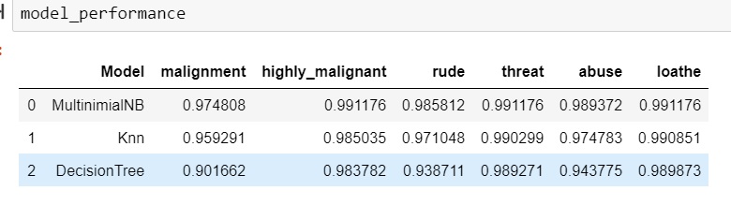
Model performance

Slide 10
conclusion
From the above study it is been observed that highly abusive words like ‘fuck’, ‘suck’, ‘cock’, etc. has been used.
Also, it is been observed mostly abusive words are based on racism, sexist, body shaming etc.
Black people are highly abused.
Multinomial models are the best performing models
In conclusion we can say, malignant comments are widely spread through social media. It not only hurts people’s emotion but also result in act of violence, building model to classify these comments will help to reduce the spread.

Slide 11
Thank you

